Slide 1


ELEN E6893 Big Data Analytics
Research Project Proposal: Spotify Classifier
Alex Thornton, Elmira Aliyeva, Tanvi Pande
Date Performed: November 5, 2021

Slide 2

Project Overview
Seek to design and implement model for unsupervised music genre classification
10,000+ songs will be sourced and processed from Spotify to perform k-means clustering
End product will be able to accept a snippet of a song, vectorize, and classify by genre
Fig 1. Spotify - source for song metadata

Slide 3
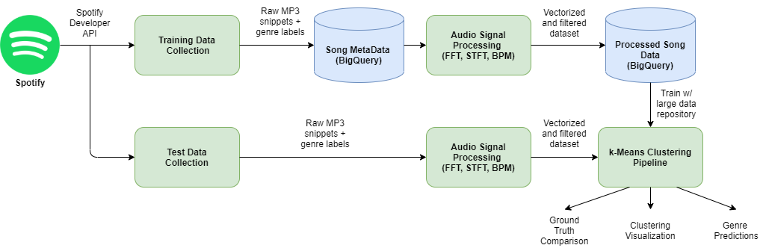
Model Architecture
Fig 2. System Diagram

Slide 4



Required Tools
Spotify Developer API
Source song metadata / mp3 samples
30 second snippets available for select songs
Google Cloud Platform
Run jobs to train model with Dataproc
Store processed song data with BigQuery
Spark ML Library
Use built in spark tools (MapReduce, k-means) for model pipeline
GitHub
Shared repository for collaboration among teammates
https://github.com/athornton1618/SpotifyClassifier
Fig 3. Tools (GCP, GitHub, Spark)

Slide 5
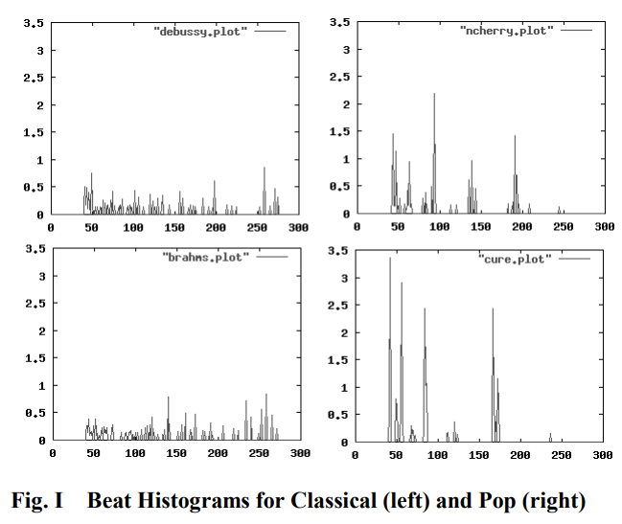
Reference Material
[1] Automatic Musical Genre Classification Of Audio Signals - Princeton CS dept
Fig 3. Beat Histogram for Classical (Left) and Pop (Right) [1]

Slide 6
Schedule
11/05 | Proposal Presentation (Today)
11/14 | Initial Progress Checkpoint (API keys, pulled sample mp3 snippet, stored in BQ)
11/19 | Progress Presentation
11/28 | Prototypes of all 3 scripts (data collection, DSP, model)
12/03 | Progress Report
12/05 | Completion of all scripts, model trained, verification
12/17 | Final Slides Submission

